Slide 1
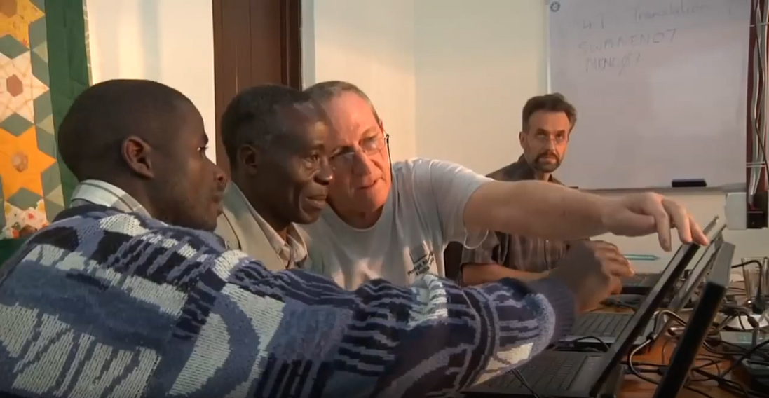
Introduction to Wycliffe Associates

Slide 2

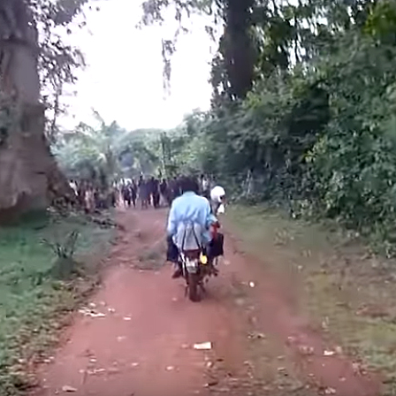
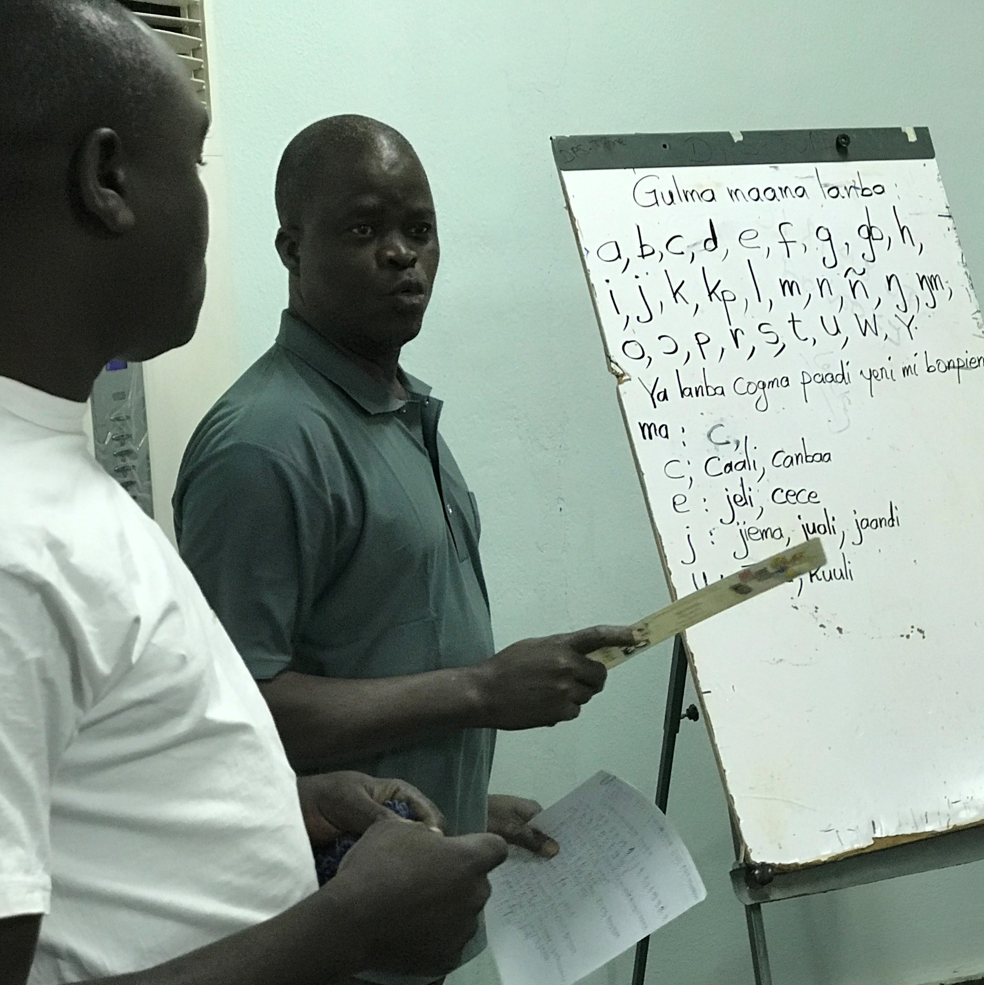
?
What do you think of when you think of Bible translation ministries?

Slide 3

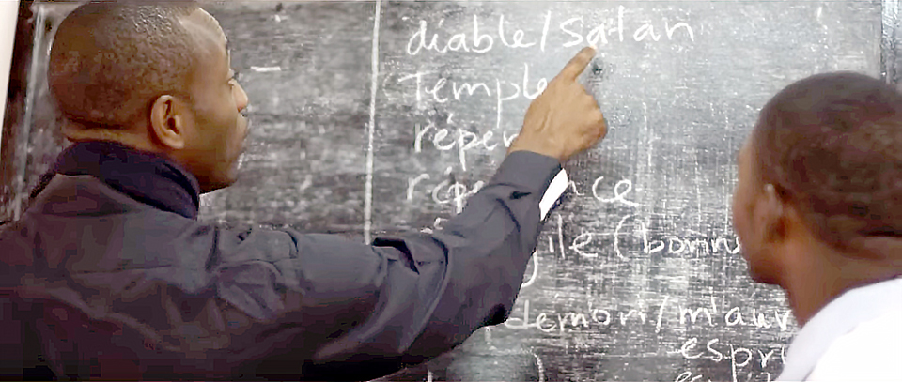
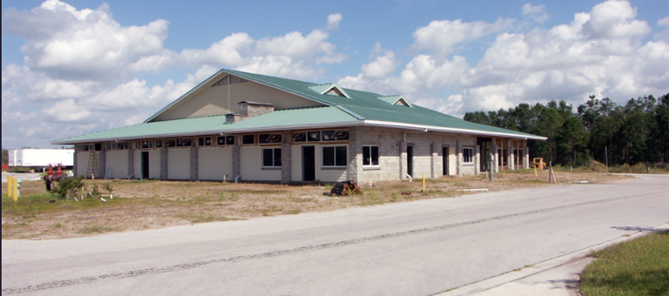
50+
Providing practical support services to Bible translation workers
YEARS

Slide 4

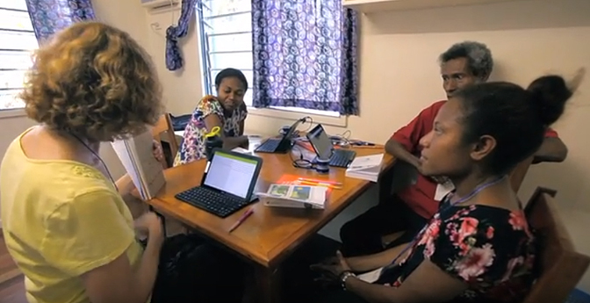
2014
First MAST translation event
Mother-tongue translators trained in this new methodology

Slide 5

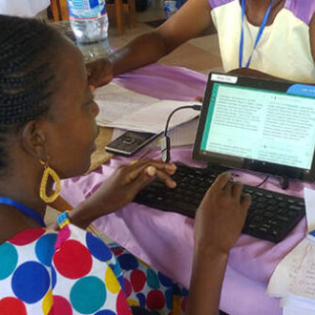

Focus shifts to training translators in MAST methodology
Now providing free, open-license resources to translators around the world

Slide 6
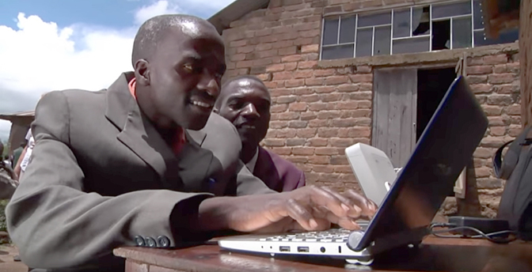
VISION:
A Bible in Every Language
Advancing Church-Owned Bible Translation through free training and tools
2 Corinthians 9:6–15
Matthew 28:19–20

Slide 7
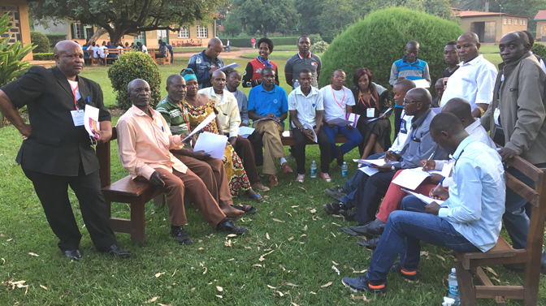
Committed to serving the local church, partnering to reach every language with Bible translation

